Slide 1
1

Slide 2

APPLIED CRYPTOGRAPHY
Lecture 43
2

Slide 3
SHA
Secure hash algorithm
3

Slide 4
Contents
Introduction
Sha-1
How SHA-1 works
SHA – 2
SHA - 3
Comparison
Application

Slide 5
Introduction
Developed by NIST along with NSA
In 1993, SHA was published as a Federal Information Processing Standard
It has following versions-
SHA – 0
SHA – 1
SHA – 2
SHA – 3

Slide 6
SHA 1
Digest sizes: 160 bits
Block sizes: 512 bits
Certification: FIPS PUB 180-4, CRYPTREC (Monitored)
Rounds: 80
Structure: Merkle–Damgård construction
First published: 1993 (SHA-0), 1995 (SHA-1)

Slide 7
SHA 2
Digest sizes: 224, 256, 384, or 512 bits
Rounds: 64 or 80
Certification: FIPS PUB 180-4, CRYPTREC, NESSIE
Designers: National Security Agency
Structure: Merkle–Damgård construction with Davies–Meyer compression function
First published: 2001

Slide 8
SHA 3
Digest sizes: arbitrary
Certification: FIPS PUB 202
Structure: sponge construction
First published: 2015
Series: (SHA-0), SHA-1, SHA-2, SHA-3
Designers: Guido Bertoni, Joan Daemen, Michaël Peeters, and Gilles Van Assche

Slide 9

SHA - 1
It works for any input message that is less than bits.
The output of SHA is a message digest of 160 bits in length.
This is designed to be computationally infeasible to:
Obtain the original message , given its message digest.
Find two messages producing the same message digest
$$2^{64}$$

Slide 10
Working of SHA 1
Steps involved
Padding of Bits
Append Length
Divide the input into 512-bit blocks
Initialize chaining variables
Process Blocks

Slide 11
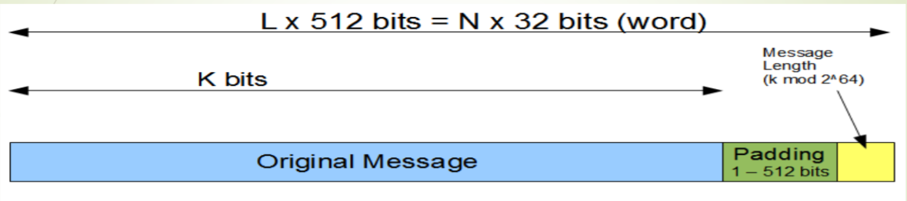
Padding of Bits and Append Length

Slide 12
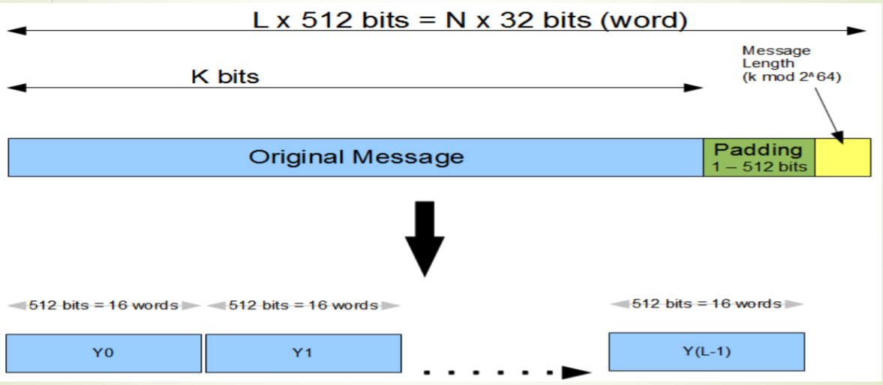
Divide the input into 512-bit blocks

Slide 13
Initialize chaining variables
Chaining Variables | Hex values
A | 01 23 45 67
B | 89 AB CD EF
C | FE DC BA 98
D | 76 54 32 10
E | C3 D2 E1 F0

Slide 14
Process Blocks
Steps involved
Copy chaining variables A-E into variables a-e.
Divide current 512-bit block into 16 subblocks of 32-bits.
SHA has 4 rounds, each consisting of 20 steps.
Each round takes 3 inputs-
 512-bit block,
 The register abcde
 A constant K[t] (where t= 0 to 79)
SHA has a total of 80 iterations (4 rounds X 20 - iterations).

Slide 15
1 Iteration of SHA
Each iteration consists of following operations:-
abcde = ( e +Process P + S5 (a) + W[t] + K[t] ), a, S30(b) , c , d
Where, abcde = The register made up of 5 variables a, b, c, d, e.
Process P = The logic operation.
St = Circular-left shift of 32-bit sub-block by t bits.
W[t[ = A 32-bit derived from the current 32-bit sub-block.
K[t] = One of the five additive constants.

Slide 16
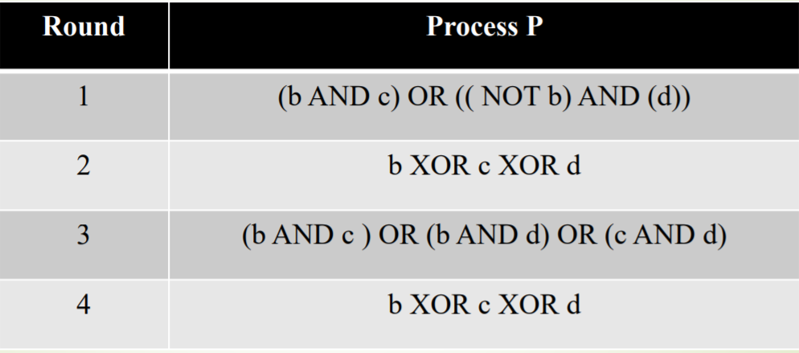
Process P in each SHA round

Slide 17
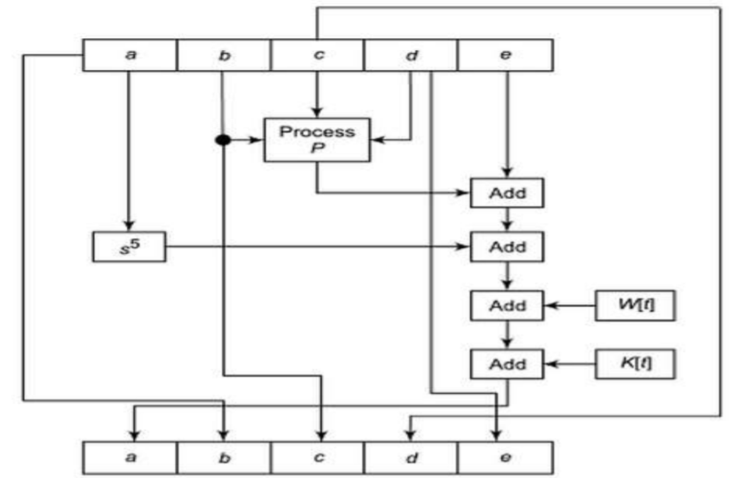
Sha 1 working

Slide 18
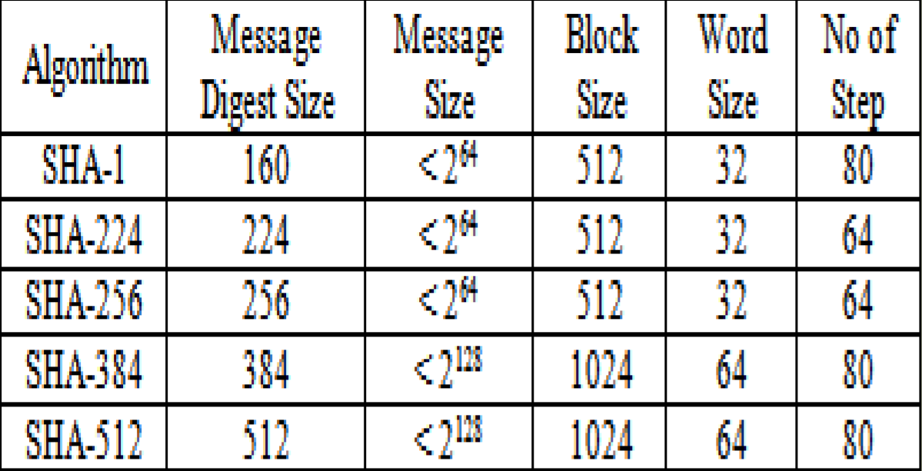
Comparison

Slide 19
Application
Secure password hashing
Secure Socket Layer (SSL) security protocol
Digital signature

Slide 20
Thank You!
Next Class
Mandatory reading for the next class
https://tools.ietf.org/html/rfc6234
20

Slide 21


Rajashree S
Computer Science and Engineering
PES University, Bengaluru
10 June 2020
21

